Slide 1

Group - 01
Sadia Islam
Md. Ahasan Khan
Md. Shahidul Islam
Ovie Rahaman Sheikh
ID: 011193156
ID: 011201122
ID: 011193107
ID: 011201306

Slide 2
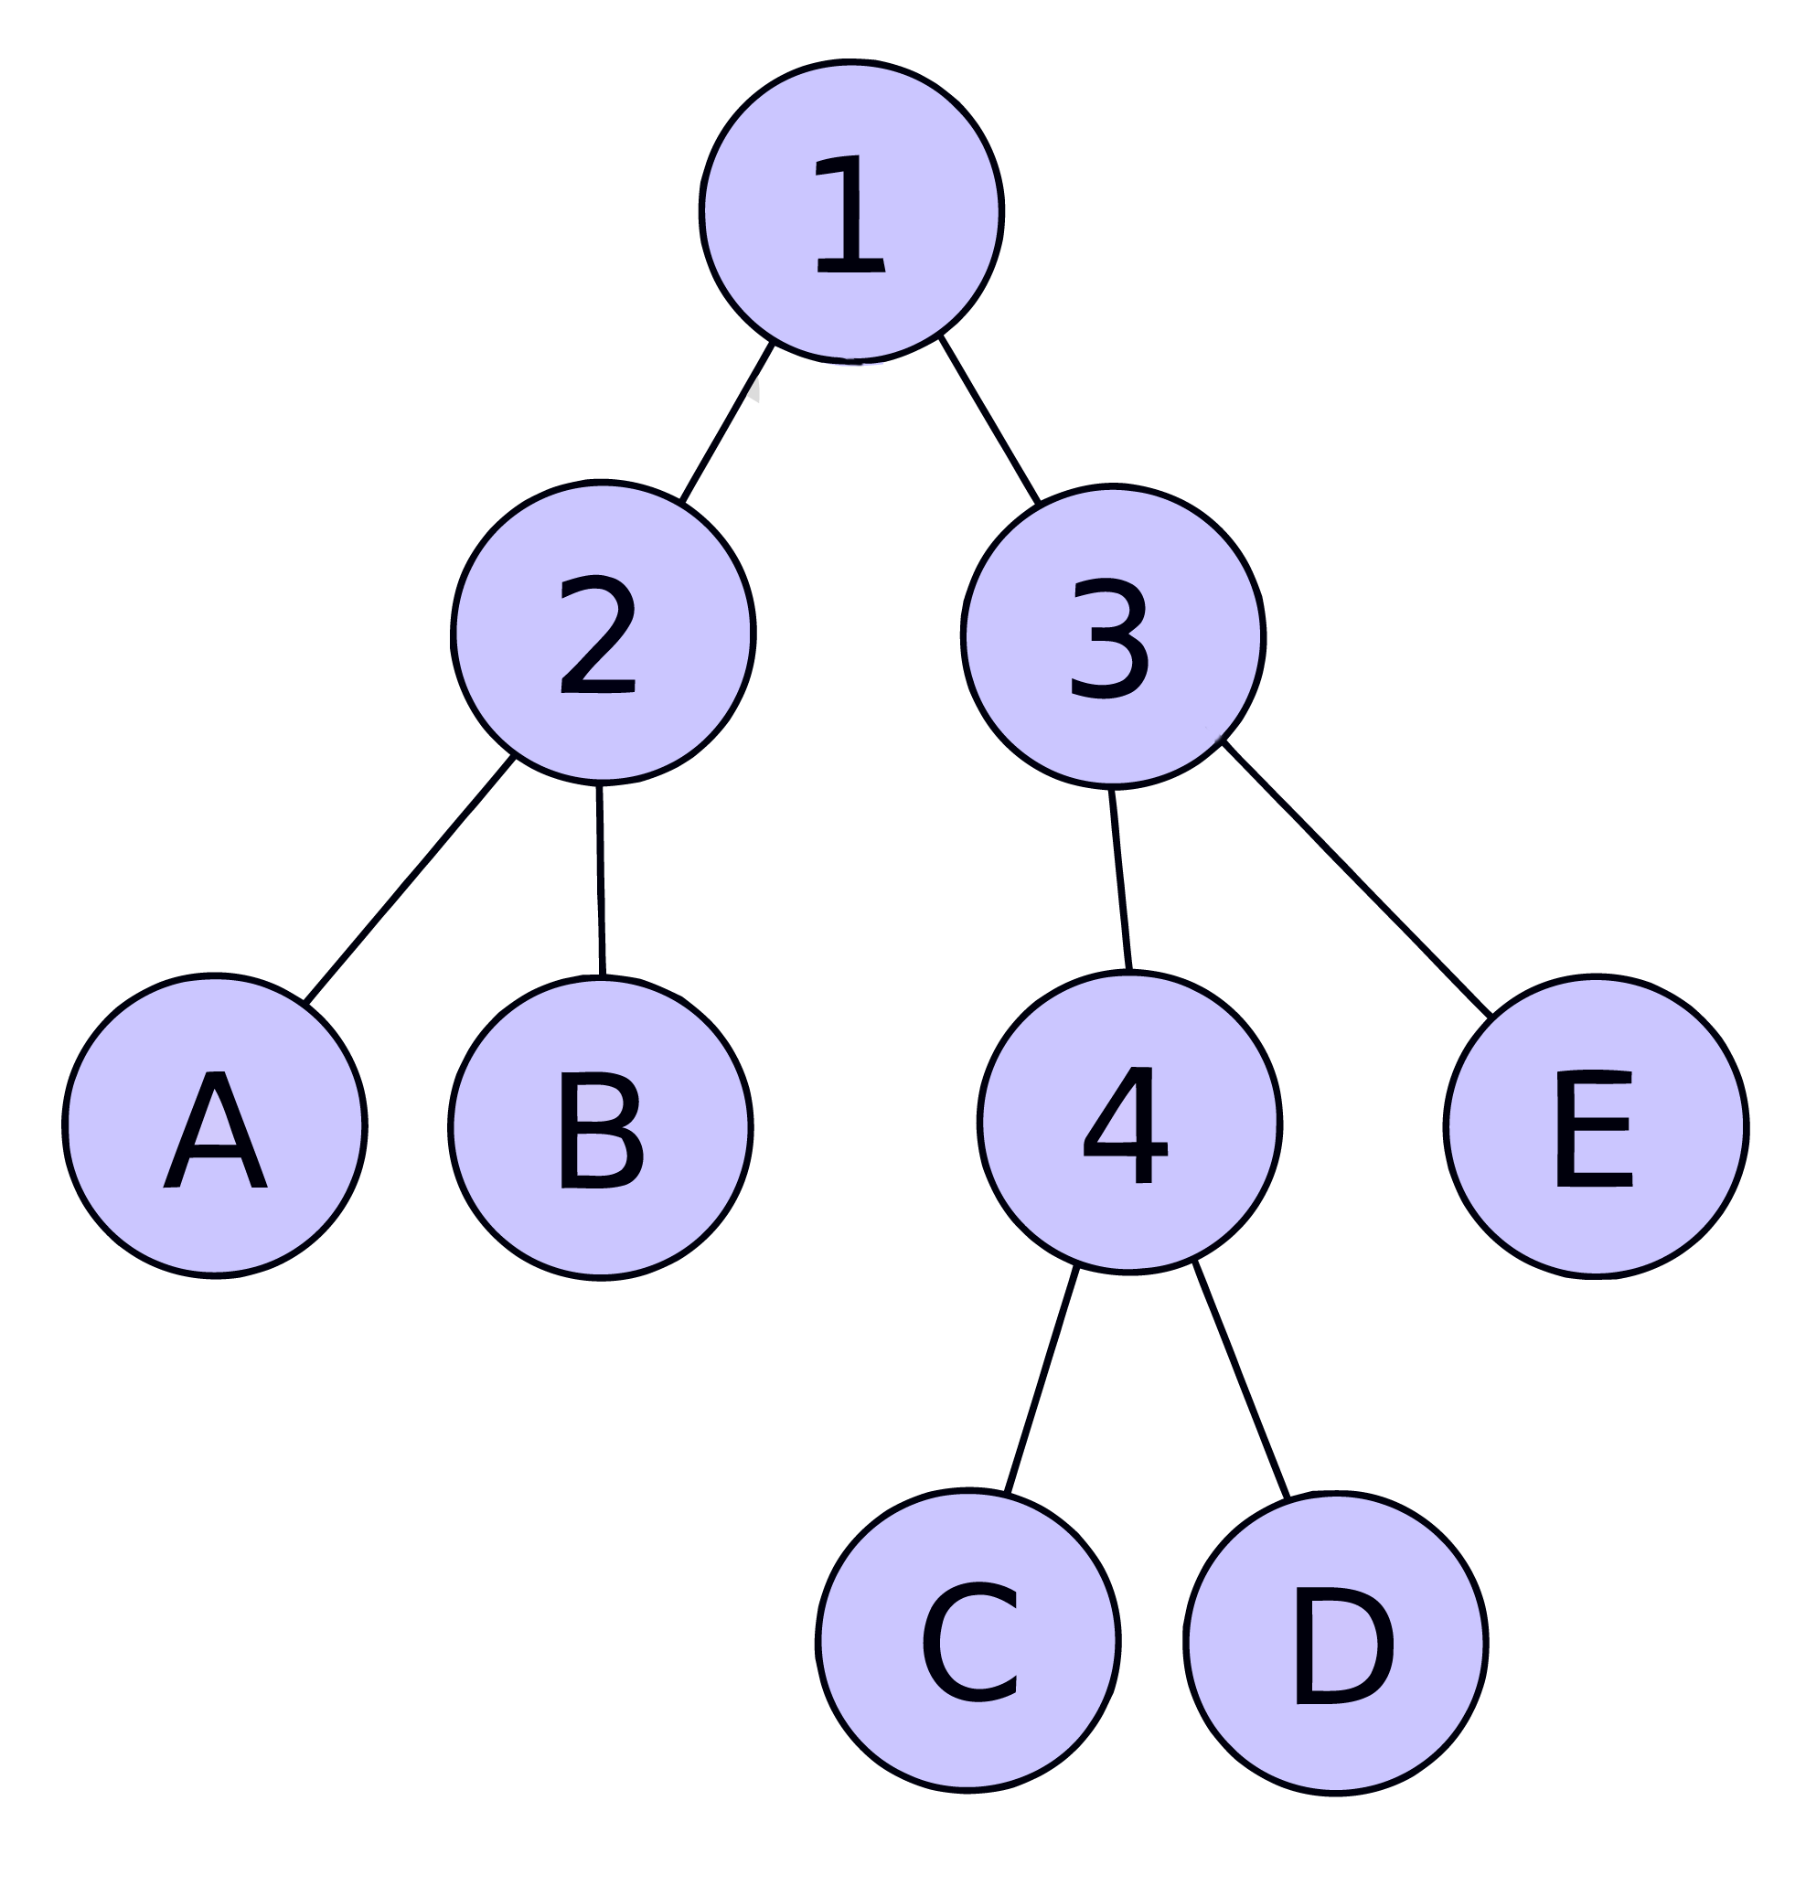
Huffman Coding Algorithm

Slide 3
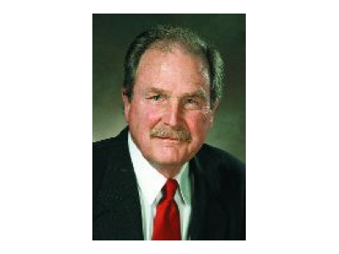

Introductions of Huffman Coding
David A. Huffman

Slide 4

Huffman Coding Applications

Slide 5
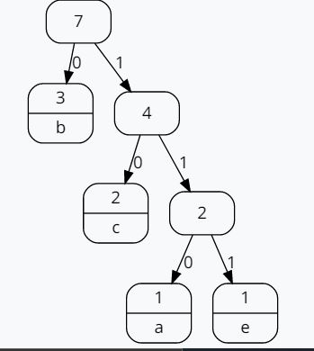
Two major parts in Huffman Coding
Build a Huffman Tree from input characters.
Travers the Huffman Tree and assign codes to characters

Slide 6
Huffman Coding Quarks
01
02
Prefix Code
The more the upper

Slide 7
Prefix Code
A
01

Slide 8

Prefix Code
A
01
B
010

Slide 9

Prefix Code
A
01
B
010
B
110

Slide 10
Prefix Code
A
01
B
010
B
110
B
00

Slide 11
Prefix Code
A
01
B
010
B
110
B
00
B
001

Slide 12
Prefix Code
A
01
B
010
B
110
B
00
B
001
B
111

Slide 13
How it Works?
Character
A B C D E
Frequency
10 5 30 4 13

Slide 14
How it Works?
Character
A B C D E
Frequency
10 5 30 4 13
1
D
B

Slide 15
How it Works?
Character
A C E 1
Frequency
10 30 13 9
1
D
B

Slide 16
How it Works?
Character
A C E 1
Frequency
10 30 13 9
1
2
D
B
1
A

Slide 17
How it Works?
Character
C E 2
Frequency
30 13 19
1
2
D
B
1
A

Slide 18
How it Works?
Character
C E 2
Frequency
30 13 19
1
2
3
D
B
1
E
A
2

Slide 19
How it Works?
Character
C 3
Frequency
30 32
1
2
3
D
B
1
E
A
2

Slide 20
How it Works?
4
Character
C 3
Frequency
30 32
C
3
1
2
3
D
B
1
E
A
2

Slide 21
How it Works?
4
Character
4
Frequency
62
C
3
1
2
3
D
B
1
E
A
2

Slide 22
How it Works?
4
C
3

Slide 23
How it Works?
4
C
3
3
E
2

Slide 24
How it Works?
4
C
3
3
E
2
2
1
A

Slide 25
How it Works?
4
C
3
3
E
2
2
1
1
A
D
B

Slide 26
How it Works?
4
C
3
3
Character
A B C D E
Frequency
10 5 30 4 13
E
2
2
1
1
A
D
B

Slide 27
Pseudocode

Slide 28
Pseudocode
1. huff(char[], freq[])

Slide 29
Pseudocode
1. huff(char[], freq[])
2. Priority_Queue q <- (freq, char)

Slide 30
Pseudocode
1. huff(char[], freq[])
2. Priority_Queue q <- (freq, char)
3. While q.size > 1:

Slide 31
Pseudocode
1. huff(char[], freq[])
2. Priority_Queue q <- (freq, char)
3. While q.size > 1:
4. a = q.pop()
5. b = q.pop()

Slide 32
Pseudocode
1. huff(char[], freq[])
2. Priority_Queue q <- (freq, char)
3. While q.size > 1:
4. a = q.pop()
5. b = q.pop()
6. q.push(a+b)

Slide 33
Pseudocode
1. huff(char[], freq[])
2. Priority_Queue q <- (freq, char)
3. While q.size > 1:
4. a = q.pop()
5. b = q.pop()
6. q.push(a+b) 7. return q.pop()

Slide 34

Why Huffman Codding ?
Example Massage: ababdcecabacdadecabc
Total massage contain 20 character
Without any algorithm its size = 20*8
= 160 bit
Fixed length code size is 115 bits
Huffman code size is 97 bits

Slide 35
Fixed length code
Character | Frequency | Code
a | 6 | 000
b | 4 | 001
c | 5 | 010
d | 3 | 011
e | 2 | 100
Total letters * ascii bit = 5*8=40 | + | Total bit = 5*3=15
Total size character size + code size + total letter*code bit
40+15+(20*3) = 115

Slide 36
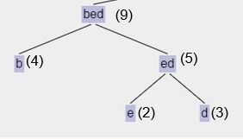
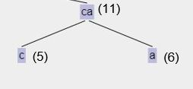

Huffman coding Tree
Sort based on frequency:
e(2) d(3) b(4) c(5) a(6)

Slide 37
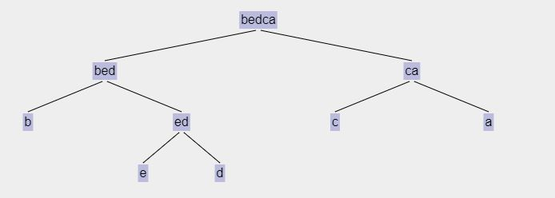
Huffman coding Tree
Sort based on frequency:
e(2) d(3) b(4) c(5) a(6)
(20)
(9)
(11)
(4)
(5)
(5)
(6)
(2)
(3)

Slide 38
Huffman coding Tree
Sort based on frequency:
e(2) d(3) b(4) c(5) a(6)
0
(20)
1
(9)
(11)
0
0
1
1
(4)
(5)
(5)
(6)
0
1
(2)
(3)

Slide 39
Huffman code
Character | Frequency | Code | Frequency * code
a | 6 | 00 | 6*2=12
b | 4 | 10 | 4*2=8
c | 5 | 11 | 5*2=10
d | 3 | 010 | 3*3=9
e | 2 | 011 | 2*3=6
Total letters * ascii bit = 5*8=40 | + | Total bits = 12 | Sum=45
Total bits of size is (40+12+45)=97 bits

Slide 40
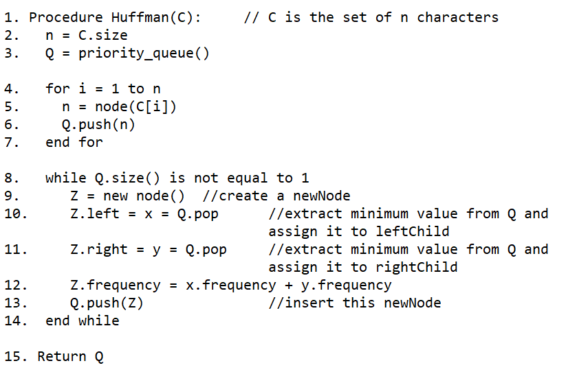
Pseudocode

Slide 41
Time complexity
The time complexity for encoding each unique character based on its frequency is O(nlog n) .
Extracting minimum frequency from the priority queue takes place 2*(n-1) times and its complexity is O(log n) .
Thus the overall complexity is O(nlog n) .

Slide 42
Code Implementation (C++)

Slide 43
Code Implementation (C++)
struct node
{
char ch;
int freq;
node *left, *right;
node(char ch, int freq)
{
this->ch = ch;
this->freq = freq;
left = right = NULL;
}
} typedef node;
typedef pair<int, node *> CH;

Slide 44
Code Implementation (C++)
node *huffman_tree(vector<pair<char, int>> &freq)
{
}
struct node
{
char ch;
int freq;
node *left, *right;
node(char ch, int freq)
{
this->ch = ch;
this->freq = freq;
left = right = NULL;
}
} typedef node;
typedef pair<int, node *> CH;

Slide 45
Code Implementation (C++)
node *huffman_tree(vector<pair<char, int>> &freq)
{
priority_queue<int, node, greater<int>> pq;
}
struct node
{
char ch;
int freq;
node *left, *right;
node(char ch, int freq)
{
this->ch = ch;
this->freq = freq;
left = right = NULL;
}
} typedef node;
typedef pair<int, node *> CH;

Slide 46
Code Implementation (C++)
node *huffman_tree(vector<pair<char, int>> &freq)
{
priority_queue<int, node, greater<int>> pq;
for (auto f : freq)
pq.push({f.second, new node(f.first, f.second)});
}
struct node
{
char ch;
int freq;
node *left, *right;
node(char ch, int freq)
{
this->ch = ch;
this->freq = freq;
left = right = NULL;
}
} typedef node;
typedef pair<int, node *> CH;

Slide 47
Code Implementation (C++)
node *huffman_tree(vector<pair<char, int>> &freq)
{
priority_queue<int, node, greater<int>> pq;
for (auto f : freq)
pq.push({f.second, new node(f.first, f.second)});
while (pq.size() > 1)
{
}
}
struct node
{
char ch;
int freq;
node *left, *right;
node(char ch, int freq)
{
this->ch = ch;
this->freq = freq;
left = right = NULL;
}
} typedef node;
typedef pair<int, node *> CH;

Slide 48
Code Implementation (C++)
node *huffman_tree(vector<pair<char, int>> &freq)
{
priority_queue<int, node, greater<int>> pq;
for (auto f : freq)
pq.push({f.second, new node(f.first, f.second)});
while (pq.size() > 1)
{
auto left = pq.top();
pq.pop();
auto right = pq.top();
pq.pop();
}
}
struct node
{
char ch;
int freq;
node *left, *right;
node(char ch, int freq)
{
this->ch = ch;
this->freq = freq;
left = right = NULL;
}
} typedef node;
typedef pair<int, node *> CH;

Slide 49
Code Implementation (C++)
node *huffman_tree(vector<pair<char, int>> &freq)
{
priority_queue<int, node, greater<int>> pq;
for (auto f : freq)
pq.push({f.second, new node(f.first, f.second)});
while (pq.size() > 1)
{
auto left = pq.top();
pq.pop();
auto right = pq.top();
pq.pop();
node *top = new node('$', left.first + right.first);
top->left = left.second;
top->right = right.second;
}
}
struct node
{
char ch;
int freq;
node *left, *right;
node(char ch, int freq)
{
this->ch = ch;
this->freq = freq;
left = right = NULL;
}
} typedef node;
typedef pair<int, node *> CH;

Slide 50
Code Implementation (C++)
node *huffman_tree(vector<pair<char, int>> &freq)
{
priority_queue<int, node, greater<int>> pq;
for (auto f : freq)
pq.push({f.second, new node(f.first, f.second)});
while (pq.size() > 1)
{
auto left = pq.top();
pq.pop();
auto right = pq.top();
pq.pop();
node *top = new node('$', left.first + right.first);
top->left = left.second;
top->right = right.second;
pq.push({top->freq, top});
}
return pq.top().second;
}
struct node
{
char ch;
int freq;
node *left, *right;
node(char ch, int freq)
{
this->ch = ch;
this->freq = freq;
left = right = NULL;
}
} typedef node;
typedef pair<int, node *> CH;

Slide 51
Code Implementation (C++)
node *huffman_tree(vector<pair<char, int>> &freq)
{
priority_queue<int, node, greater<int>> pq;
for (auto f : freq)
pq.push({f.second, new node(f.first, f.second)});
while (pq.size() > 1)
{
auto left = pq.top();
pq.pop();
auto right = pq.top();
pq.pop();
node *top = new node('$', left.first + right.first);
top->left = left.second;
top->right = right.second;
pq.push({top->freq, top});
}
return pq.top().second;
}
struct node
{
char ch;
int freq;
node *left, *right;
node(char ch, int freq)
{
this->ch = ch;
this->freq = freq;
left = right = NULL;
}
} typedef node;
typedef pair<int, node *> CH;

Slide 52
Thanks
Do you have any questions?
sislam193156@bscse.uiu.ac.bd
mkhan201122@bscse.uiu.ac.bd
mislam193107@bscse.uiu.ac.bd
osheikh201306@bscse.uiu.ac.bd

